Slide 1



DEPARTMENT OF COMPUTER SCIENCE & ENGINEERING
Domain Winter Winning Camp 2023
Subject Name: Database Management System
Day: 1
Topics Covered:Introduction to Oracle platform, DBMS, RDBMS and SQL commands
DISCOVER . LEARN . EMPOWER

Slide 2
Prerequisites, Objectives and Outcomes
Prerequisite of topic: Fundamentals of DBMS, Basic knowledge of Oracle 11g.
Objective: To gain knowledge of DBMS, both in terms of use and implementation/design.
To master the basics of SQL and construct queries using SQL.
Outcome : Implement relational databases using a RDBMS and formulate SQL queries on the data.

Slide 3
BASIC DEFINITIONS
Database: A collection of related data.
Data: Known facts that can be recorded and have an implicit meaning.
Database Management System (DBMS): A software package/ system to facilitate the creation and maintenance of a computerized database.
Database System: The DBMS software together with the data itself. Sometimes, the applications are also included.

Slide 4
RELATIONAL DATABASE MANAGEMENT SYSTEM (RDBMS):
RDBMS data is structured in database tables, fields and records.
Each RDBMS table consists of database table rows.
Each database table row consists of one or more database table fields.
RDBMS store the data into collection of tables, which might be related by common fields (database table columns).
RDBMS also provide relational operators to manipulate the data stored into the database tables.
Most RDBMS use SQL as database query language.
Edgar Codd introduced the relational database model.
The most popular RDBMS are MS SQL Server, DB2, Oracle and MySQL. Most RDBMS use SQL as database query language.

Slide 5
What is RDBMS?
A relational database management system (RDBMS or just RDB) is a common type of database that stores data in tables, so it can be used in relation to other stored datasets.
Most databases used by businesses these days are relational databases, as opposed to a flat file or hierarchical database.
The majority of current IT systems and applications are based on a relational DBMS.

Slide 6
Difference between DBMS and RDBMS?
S.No. | DBMS | RDBMS
1 | DBMS applications store data as file. | RDBMS applications store data in a tabular form.
2 | In DBMS, data is generally stored in either a hierarchical form or a navigational form. | In RDBMS, the tables have an identifier called primary key and the data values are stored in the form of tables.
3 | Normalization is not present in DBMS. | Normalization is present in RDBMS.
4 | DBMS does not apply any security with regards to data manipulation. | RDBMS defines the integrity constraint for the purpose of ACID (Atomocity, Consistency, Isolation and Durability) property.
5 | DBMS uses file system to store data, so there will be no relation between the tables. | in RDBMS, data values are stored in the form of tables, so a relationship between these data values will be stored in the form of a table as well.

Slide 7
Continued….
S.No. | DBMS | RDBMS
1 | DBMS has to provide some uniform methods to access the stored information. | RDBMS system supports a tabular structure of the data and a relationship between them to access the stored information.
2 | DBMS does not support distributed database. | RDBMS supports distributed database.
3 | DBMS is meant to be for small organization and deal with small data. it supports single user. | RDBMS is designed to handle large amount of data. it supports multiple users.
4 | Examples of DBMS are file systems, xml etc. | Example of RDBMS are mysql, postgre, sql server, oracle etc.

Slide 8
ORACLE 11G
Oracle Database 11g Programming with SQL is focused on:
Querying a Database with SQL
Conversion Functions, Conditional Expressions, Group Functions, and Joins
Manipulating Queries and Data
Using DDL, Views, and Schema Objects
Controlling User Access and Managing Objects
Managing Data Dictionary Views and Large Data Sets
Managing Time Zones and Date-time Functions
Sub queries and Regular Expressions

Slide 9
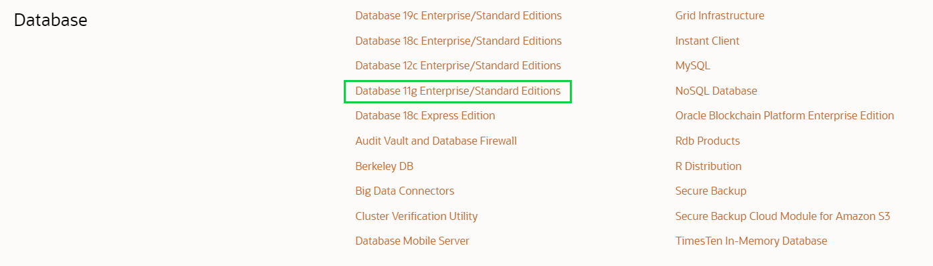
Installation Steps of Oracle 11g
Step 1: Go to oracle.com and Click on Options Menu
Step 2: Click the Download Button and Scroll Down to Database Section.

Slide 10
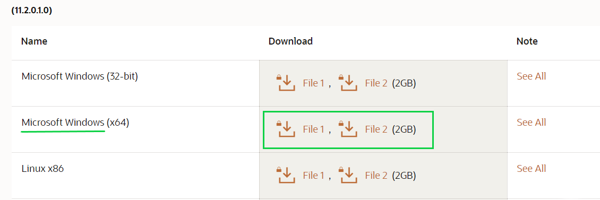
Installation Steps of Oracle 11g
Step 3: Click Database 11g Enterprise/Standard Editions, after which you’ll find different versions of Oracle for different OS. Download the Files according to your OS.

Slide 11
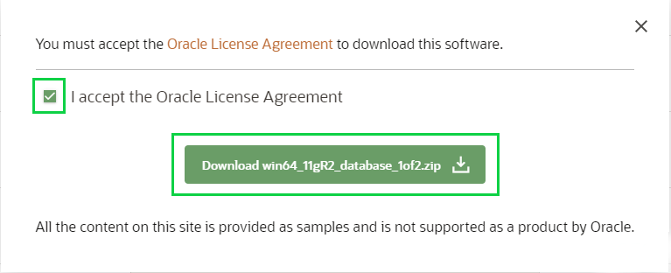
Installation Steps of Oracle 11g
Step 4: After Clicking the Download Button, the page will be directed to Login Screen where you’ll need to Sign In in Oracle Account. If you don’t have one, then you must Sign Up, because without that you won’t be able to download the Files.

Slide 12
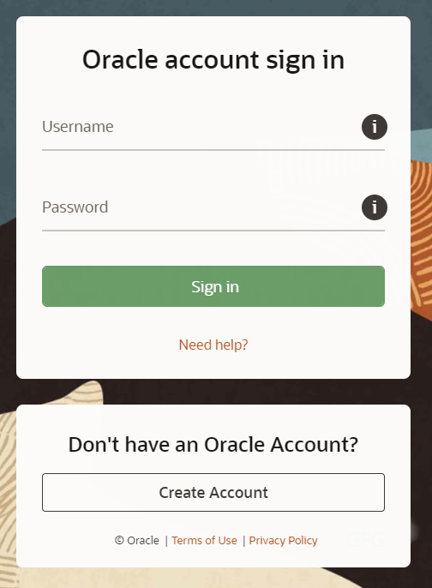
Installation Steps of Oracle 11g
Oracle Account Sign in

Slide 13
Installation Steps of Oracle 11g
Step 5: Repeat the same steps for both the Files and Download them.
After downloading the files Successfully, you’ll find both Files in Downloads Folder where both of them will be in Compressed Form, so you’ll need to Extract them.

Slide 14
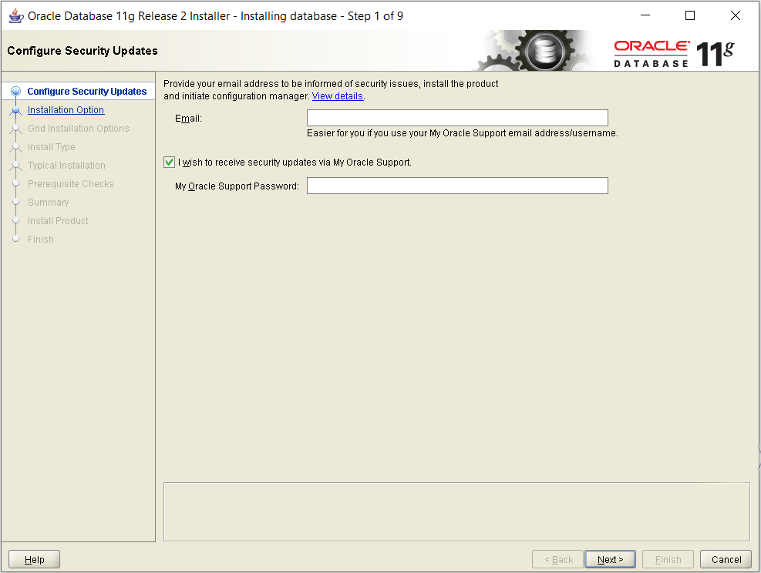
Installation of Oracle Database
Step 1: Go to Main Database Folder where you’ll find Setup. Right click the setup.exe file and choose Run as Administrator.
Step 2: Click Yes to continue. This will start Oracle Universal Installer
Step 3: Provide your Email Address to receive all the Notifications and News Alerts from Oracle.

Slide 15
Installation of Oracle Database
Step 4: Select any of the three different Installation Options according to your needs.
Option 1 – If you want to Install Oracle Server Software and want to Create Database also.
Option 2 – If you want to Install Oracle Server only.
Option 3 – If you want to Upgrade your Existing Database.
Step 5: Choose between Server Class and Desktop Class as per your requirement and click on Next.
Step 6: Configure the basic settings and create a Password for your database. Once the configuration is done click on Next to continue.

Slide 16
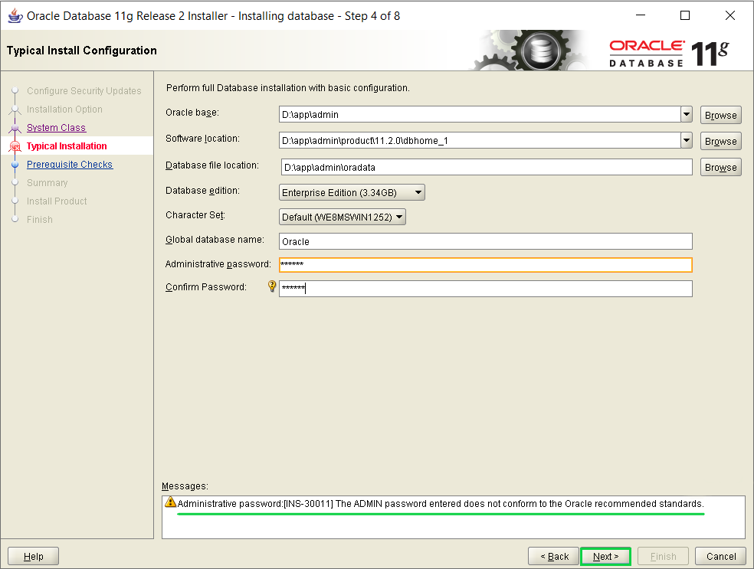
Installation of Oracle Database (Conti.)

Slide 17
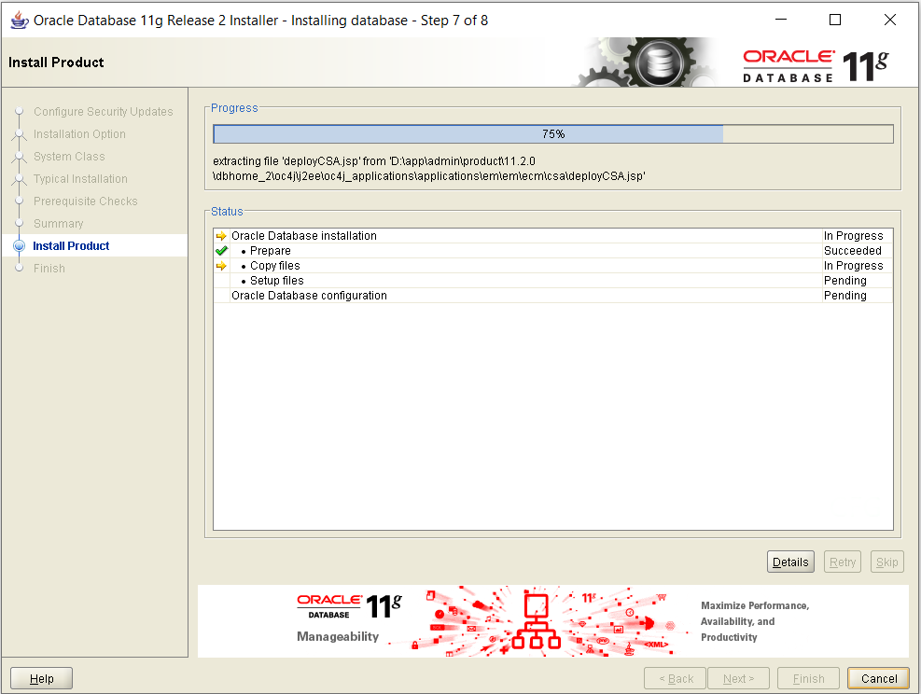
Installation of Oracle Database (Conti.)
Step 7: Here, Oracle Universal Installer(OUI) will check for the Prerequisites such as Hardware compatibility.
If there will be any Errors, then OUI will show them here and will recommend the changes.
Step 8: Click on Finish to start the Installation process. This installation might take some time depending on your Hardware.

Slide 18
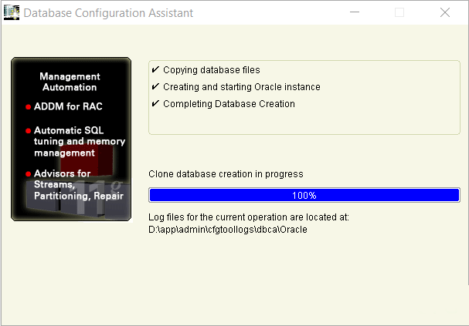
Installation of Oracle Database (conti.)
Step 9: Click OK to finish the installation.

Slide 19
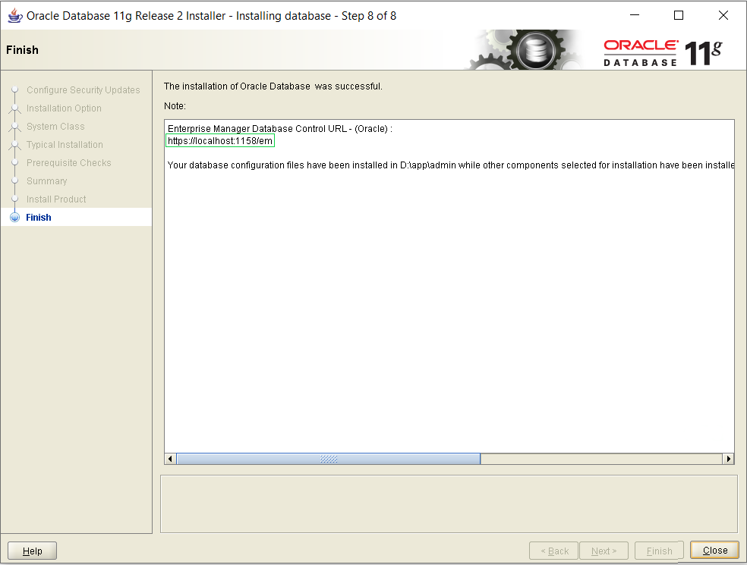
Installation of Oracle Database (conti.)
Step 10: Copy the localhost link provided to open your Enterprise Manager. Click the Close Button and you are done with the Installation Process

Slide 20
INTRODUCTION TO LIVE SQL
Live SQL provides an introduction to the Structured Query Language (SQL), learn how to create tables with primary keys, columns, constraints, indexes, and foreign keys.
We can work on various platforms if we have the software but when there is a issue of not having software we can use Live SQL.
To work onto this module, click on the link given below
https://livesql.oracle.com/apex/f?p=590:1000

Slide 21
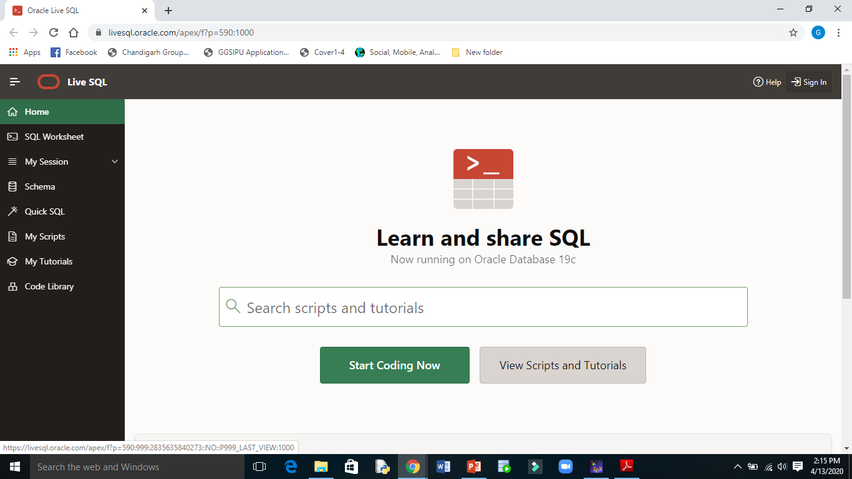
Step1: Click on Sign In

Slide 22
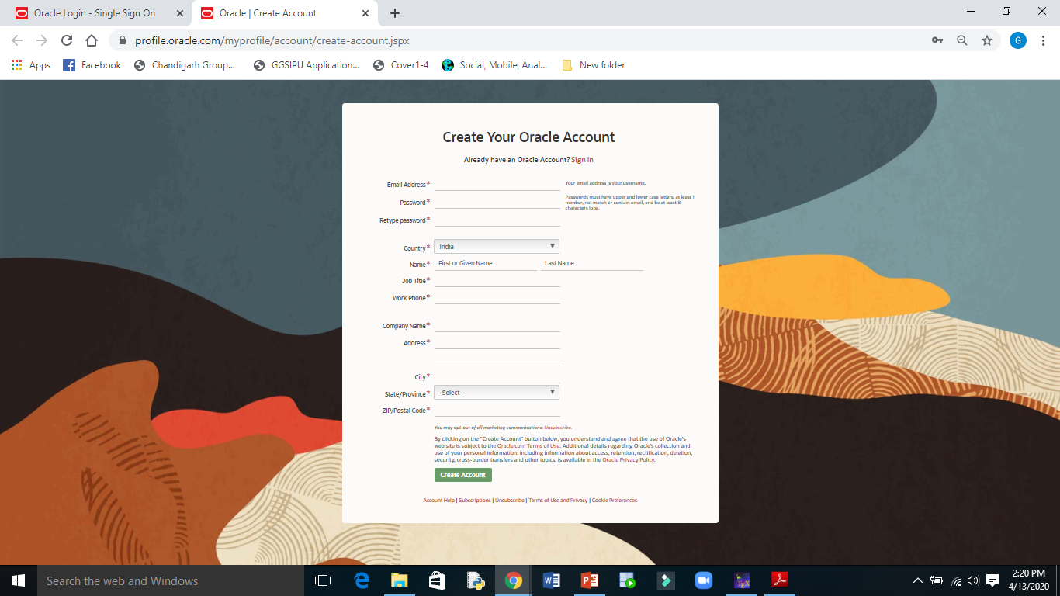
Step2: Click on create account and fill the required details

Slide 23
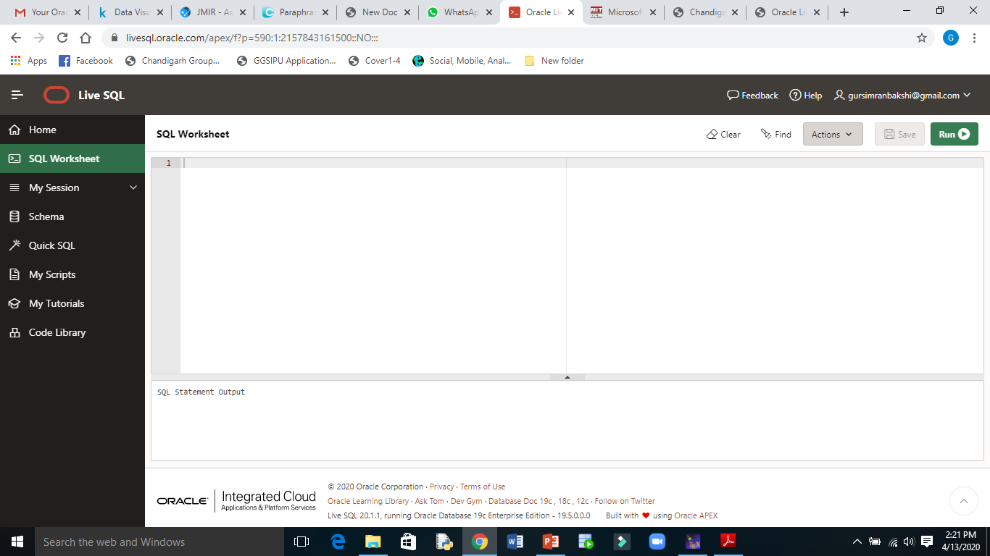
Step3: Click on SQL Worksheet

Slide 24
INTRODUCTION TO SQL
SQL stands for Structured Query Language.
SQL lets you access and manipulate databases.
SQL can execute queries against a database
SQL can retrieve data from a database
SQL can insert records in a database
SQL can update records in a database
SQL can delete records from a database
SQL can create new databases
SQL can create new tables in a database
SQL can create stored procedures in a database
SQL can create views in a database
SQL can set permissions on tables, procedures, and views and many more

Slide 25
DATA TYPES COMMONLY USED IN SQL
CHAR (size): This data type is used to store character strings values of fixed length.
The size in the brackets determines the number of characters it can hold.
The maximum number of characters (i.e. the size) this data type can hold is 255 characters.
The data held is right padded with spaces to whatever length specified.
VARCHAR (size): This data type is used to store variable length alphanumeric data.
It is a flexible form of CHAR data type.
The maximum data this data type can hold is 4000 characters.
DATE: This data type is used to represent date.
Date time stores date in the 24-hour format.
NUMBER (P,S): The NUMBER data type is used to store numbers(fixed or floating point).
Numbers of virtually any magnitude maybe stored up to 38 digits of precision.

Slide 26
SQL COMPONENTS
SQL consists of three components:
1. Data Definition Language (DDL)
2. Data Manipulation Language (DML)
3. Data Control Language (DCL)

Slide 27
DATA DEFINITION LANGUAGE (DDL)
This component of the SQL language is used to create and modify tables and other objects in the database.
For tables there are three main commands:
CREATE TABLE tablename 🡪 to create a table in the database
DROP TABLE tablename 🡪 to remove a table from the database
ALTER TABLE tablename 🡪 to add or remove columns from a table in the database
RENAME <new table name> to <old table name>; 🡪 To change the name of a table as per the user’s wish or requirement.
TRUNCATE TABLE<table name>; 🡪 Truncate Tables empties the table completely. Once the data deleted cannot be retrieved.
DESC tablename 🡪 To view just the blank table

Slide 28
CREATE DATABASE COMMAND
Purpose:- Database is collection of tables that are the basic unit of data storage in an Oracle Database. Data is stored in rows and columns.
Syntax:- CREATE DATABASE databasename;
Example:-
Create database testdb;

Slide 29
CREATE TABLE COMMAND
Purpose:- Tables are the basic unit of data storage in an Oracle Database. Data is stored in rows and columns.
Syntax:- Create table <TableName> (<ColumnName1> <Data Type>(<Size>), <ColumnName2> <Data Type>(<Size>), ………..<ColumnName n> <Data Type>(<Size>));
Example:-
Create table STUDENT (Roll_no number(5), Name varchar2(20), Branch varchar2(10));

Slide 30
ALTER TABLE COMMAND
Purpose:- The structure of a table can be modified by using a alter table command. Alter Table allows changing the structure of an existing table. With Alter Table it is possible to add or delete columns, create or destroy indexes, change the data type of existing columns, or rename columns or the table itself
Syntax:-
✓ Adding New Columns
Alter table <table name> add(<new col name> <data type> (<Size>), <new col name> <data type> (<Size>),…..);
✓ Modifying Existing Column
Alter table <table name> modify(<col name> <new data type> (< new Size>), <col name> <new data type> (<new Size>),…..);
✓ Dropping A Column
Alter table <table name> drop column <col name>;

Slide 31
Example:-
Alter table STUDENT add( Telephone number(10));
Alter table STUDENT modify( Telephone number(20));
Alter table STUDENT drop column Telephone;

Slide 32
RENAME TABLE COMMAND
Purpose:- To change the name of a table as per the user’s wish or requirement.
Syntax:- Rename <new table name> to <old table name>;
Example:- Rename STUDENT to group_a101;

Slide 33
DROP TABLE COMMAND
Purpose:- Sometimes table in the database becomes obsolete and need to be discarded, so we use drop table command.
Syntax:- Drop table <table name>;
Example:-
Drop table CSEA_Data101;

Slide 34
DATA MANIPULATION LANGUAGE (DML)
DML component of the SQL language is used to manipulate data within a table. There are four main commands:
SELECT 🡪 to select rows of data from a table
INSERT 🡪 to insert rows of data into a table
UPDATE 🡪 to change rows of data in a table
DELETE 🡪 to remove rows of data from a table

Slide 35
INSERT COMMAND
Command:- Insert data into a table
Purpose:- The Insert Into Table command is used to load the created table with data to be manipulated later.
Syntax:- Insert into <table name>(<col1>,<col2>,……..,<col n>) values (<expression1>, <expression2> ,……,<expression3>);
Example:-
Insert into STUDENT values(101, ‘Aanchal’, ’CSE’);
Insert into STUDENT values(126, ‘Jotnain’, ’CSE’);
Insert into STUDENT values(149, ‘Sapanpreet’, ’ECE’);
Insert into STUDENT values(151, ‘Savita’, ’CSE’);

Slide 36
INSERT DATA INTO A TABLE FROM A TABLE (Copying contents of a table to another table)
Command:- Insert into….Select
Purpose:- To filter the data that is not required
Syntax:- Insert into <table name>Select <col name1>, <col name2>…. from <table name>;
Example:-
Insert into CSEA_Data101 Select roll_no,name from STUDENT where roll_no=149;

Slide 37
SELECT COMMAND
Command:- (a) Selecting all rows and all columns
Purpose:- This command is used to view all the rows and columns of the table created in the database.
Syntax:- Select * from <table name>;
Example:-
Select * from STUDENT;

Slide 38
SELECT COMMAND
(b) Selected rows and all columns using where clause
Purpose:- If the information of a particular student is to be retrieved from a table, its retrieval must be based on a specific condition
Syntax:- Select * from <table name> where <condition>;
Example:-
Select * from STUDENT where roll_no=151;

Slide 39
ALIAS
Purpose:- SQL aliases are used to give a table, or a column in a table, a temporary name.
ALIAS COLUMN SYNTAX
Syntax:- SELECT column_name AS alias_name FROM table_name;
Example:-
SELECT CustomerID AS ID, CustomerName AS Customer FROM Customers;

Slide 40
ALIAS TABLE SYNTAX
Syntax:- SELECT column_name(s) FROM table_name AS alias_name;
Example:-
SELECT o.OrderID, o.OrderDate, c.CustomerName FROM Customers AS c, Orders AS o WHERE c.CustomerName='Around the Horn' AND c.CustomerID=o.CustomerID;

Slide 41
DELETE COMMAND
Purpose:- To delete the rows from the table that satisfies the condition provided by its where clause and returns the number of records deleted.
Syntax:- Removal of all rows
Delete from <table name>;
Removal of Specific Row(s)
Delete from <table name> where <condition>;
Example:-
Delete from CSEA_Data101;
Delete from CSEA_Data101 where rollno=149;

Slide 42
DIFFERENCE OF DELETE & TRUNCATE
TRUNCATE
TRUNCATE is a DDL command
TRUNCATE is executed using a table lock and the whole table is locked to remove all records.
We cannot use the WHERE clause with TRUNCATE.
TRUNCATE removes all rows from a table.
Minimal logging in the transaction log, so it is faster performance-wise.
DELETE
DELETE is a DML command.
DELETE is executed using a row lock, each row in the table is locked for deletion.
We can use where clause with DELETE to filter & delete specific records.
The DELETE command is used to remove rows from a table based on WHERE condition.
It maintains the log, so it slower than TRUNCATE.

Slide 43
DROP COMMAND
The DROP command removes a table from the database.
All the tables' rows, indexes, and privileges will also be removed.
No DML triggers will be fired.
The operation cannot be rolled back.
DROP and TRUNCATE are DDL commands, whereas DELETE is a DML command.
DELETE operations can be rolled back (undone), while DROP and TRUNCATE operations cannot be rolled back

Slide 44
Difference between DELETE, DROP and TRUNCATE
DELETE | DROP | TRUNCATE
1. It is a DML command. | 1. It is a DDL command. | 1. It is a DDL command.
2. It is used to delete rows or records based on conditions specified in the WHERE clause. | 2. It is used to delete the entire table along with its schema and structure respectively. | 2. It is used to delete the entire records of a table without affecting the schema of the table.
3. If the WHERE clause is not specified with conditions it deletes all the records of the table. | 3. There is no WHERE clause. | 3. There is no WHERE clause.
4. It is a DML command. As a result, the operation can be rolled back. | 4. It is a DDL command. As a result, the changes cannot be rolled back or undone. | 4. It is a DDL command. As a result, the changes cannot be rolled back or undone.
5. It scans every row before deleting making it slower and time-consuming. | 5. It is faster and time-saving. | 5. It is faster than DELETE in execution because it does not scan every row before deleting which makes it the least time-consuming.
6. Syntax: DELETE FROM TABLE Table_Name WHERE [CONDITIONS]; | 6. Syntax: DROP TABLE Table_Name; | 6. Syntax: TRUNCATE TABLE Table_Name;

Slide 45
UPDATE COMMAND
Purpose:- The Update statement updates columns in the existing table’s rows with new values. The Set clause indicates which column data should be modified and the new valued they should hold.
Syntax:-
✓ Updating Specific Records
Update <table name> set <col name1>=<expression1>, <col name2>=<expression2> where <condition>;
✓ Updating All The Records
Update <table name> set <col name1>=<expression1>, <col name2>=<expression2>;
Example:-
Update STUDENT set Branch=’ECE’ where roll_no=101;
Update STUDENT set Branch=’CSE’;

Slide 46
DATA CONTROL LANGUAGE (DCL)
This component of the SQL language is used to create privileges to allow users access to, and manipulation of the database. There are two main commands:
GRANT 🡪 to grant a privilege to a user
REVOKE 🡪 to revoke (remove) a privilege from a user.

Slide 47
What is dbms?
Before we learn Database Management System (DBMS), let's understand that What is a file storage and Database?
File storage, also called file-level or file-based storage, stores data in a hierarchical structure. The data is saved in files and folders, and presented to both the system storing it and the system retrieving it in the same format.
A database is a collection of related data which represents some aspect of the real world. A database system is designed to be built and populated with data for a certain task.

Slide 48
Continued….
Now come to dbms:
Database Management System (DBMS) is a software for storing and retrieving users' data while considering appropriate security measures. It consists of a group of programs which manipulate the database.
The DBMS accepts the request for data from an application and instructs the operating system to provide the specific data.
In large systems, a DBMS helps users and other third-party software to store and retrieve data.
DBMS allows users to create their own databases as per their requirement. The term “DBMS” includes the user of the database and other application programs.
It provides an interface between the data and the software application.

Slide 49
Three tier Architecture
Before discussing 3-tier architecture we should know that what is 1 tier and 2-tier.
1 Tier Architecture in DBMS is the simplest architecture of Database in which the client, server, and Database all reside on the same machine. A simple one tier architecture example would be anytime you install a Database in your system and access it to practice SQL queries. But such architecture is rarely used in production.
A 2 Tier Architecture in DBMS is a Database architecture where the presentation layer runs on a client (PC, Mobile, Tablet, etc.), and data is stored on a server called the second tier. Two tier architecture provides added security to the DBMS as it is not exposed to the end-user directly. It also provides direct and faster communication.

Slide 50
Continued….
A 3 Tier Architecture in DBMS is the most popular client server architecture in DBMS in which the development and maintenance of functional processes, logic, data access, data storage, and user interface is done independently as separate modules.
Three Tier architecture contains a presentation layer, an application layer, and a database server.
3-Tier database Architecture design is an extension of the 2-tier client-server architecture. A 3-tier architecture has the following layers:
Presentation layer (your PC, Tablet, Mobile, etc.)
Application layer (server)
Database Server

Slide 51
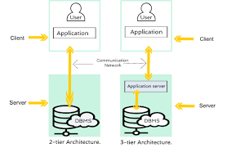

Slide 52
Continued…
The Application layer resides between the user and the DBMS, which is responsible for communicating the user's request to the DBMS system and send the response from the DBMS to the user.
The application layer(business logic layer) also processes functional logic, constraint, and rules before passing data to the user or down to the DBMS.

Slide 53
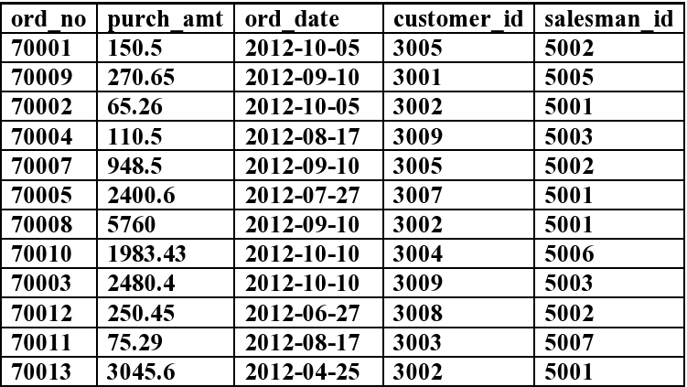
Practice Question 1
Consider the following schema

Slide 54
Practice Question 1 (Conti.)
Create the table orders with columns order_no number type, purch_amt number (precision, scale), ord_date date, customer_id number and salesman_id number
Insert the values as given in the table
Add customer name, email address and contact_number columns in the given table
Add column gender in the table with a single character value.
Update the values of newly added columns in the records.
Create another table orders_completed with ord_no, purch_amt, ord_date and customer name, email_address and contact number. Then copy the information of details from the orders table where the date is 10th October 2012.

Slide 55
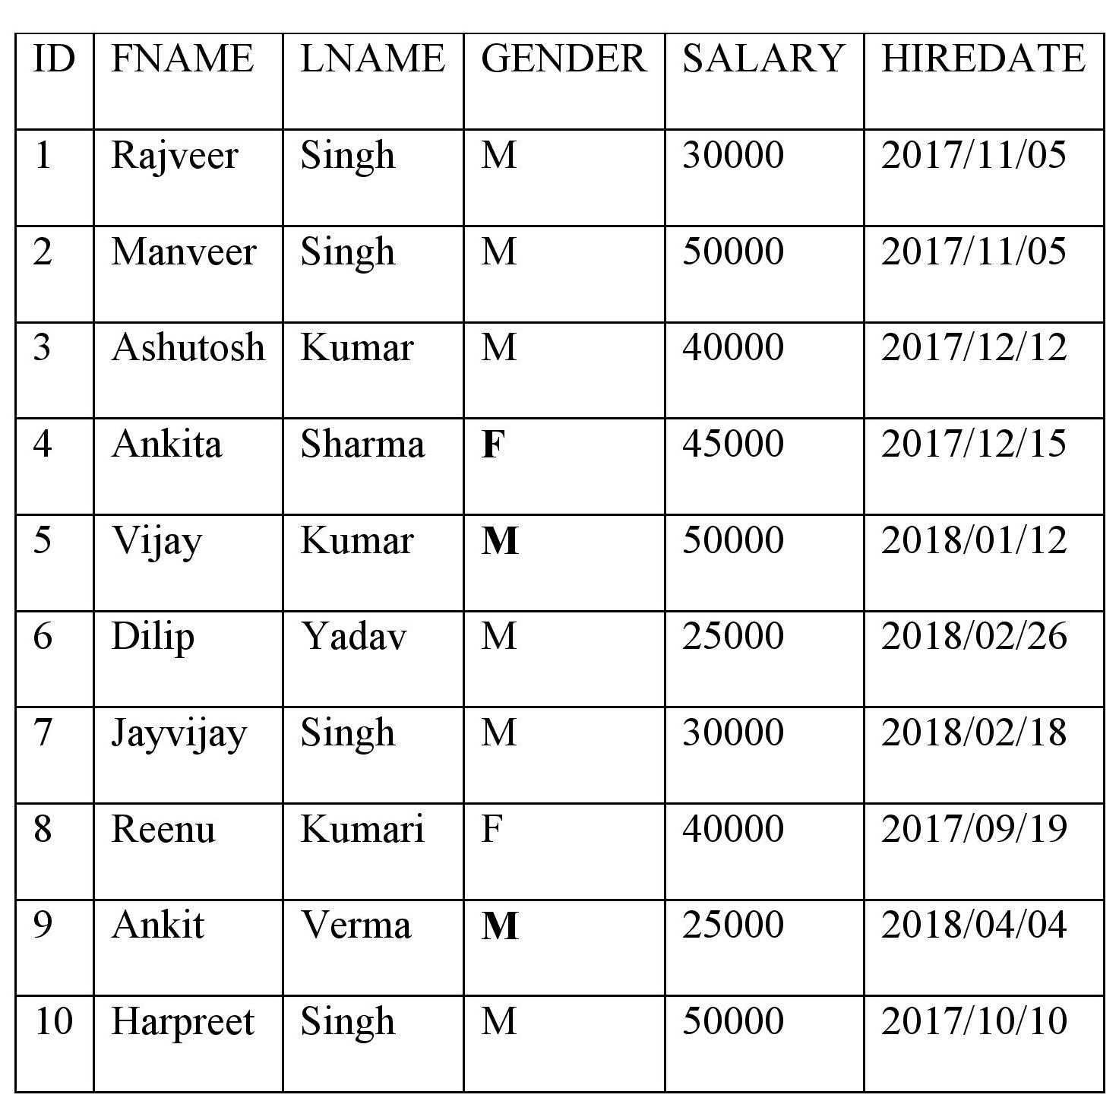
Practice Question 2
Consider the following schema

Slide 56
Practice Question 2 (Conti.)
Create a table Employee.
Insert the values as mentioned.
Add column Employee ID as identity column.
Modify the column salary to store floating point values.
Rename the attribute FNAME to Emp_name.
Drop column LNAME from the employee table.
Add column Department with default value as ‘CSE’
Add an annual increment to the salary of an employee whose joining date is 19th September 2017.
Modify the department value of DILIP and VIJAY to ME
Delete the employees belonging to ME department

Slide 57
Interview Questions
What is dbms and file storage ?
What do you mean by RDBMS?
Difference between DBMS and RDBMS?
What is Primary key in DBMS?
What are the basic concepts of DBMS and its queries.
What is dbms query?
How to Create a database.

Slide 58
FURTHER READINGS
EF Codd’s Rules -- https://www.tutorialcup.com/dbms/codds-rule.htm
Introduction to databases.pdf
https://nptel.ac.in/courses/106105175/
https://www.edureka.co/blog/sql-commands
https://docs.oracle.com/cd/E14373_01/user.32/e13370/sql_proc.htm

Slide 59
Thank you

